Slide 1
MECM Admin role support

Slide 2
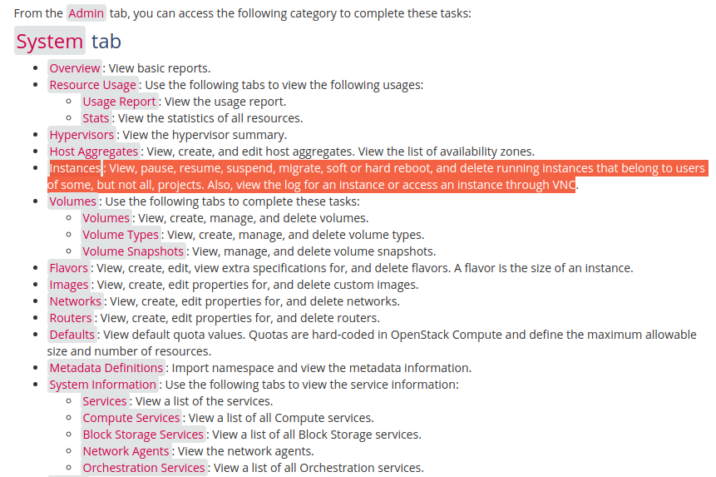
Openstack
Administrative operations¶
The administrator can run any openstack command on behalf of projects by specifying an Identity project
https://docs.openstack.org/ocata/user-guide/dashboard-log-in.html
https://docs.openstack.org/horizon/latest/admin/manage-instances.html
https://docs.openstack.org/horizon/latest/user/launch-instances.html
https://ask.openstack.org/en/question/2032/create-admin-user-within-single-tenant/#:~:text=By%20default%20the%20admin%20role,objects%20owned%20by%20ANY%20TENANT.

Slide 3
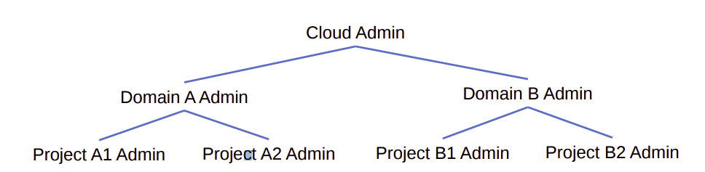
Administrators(system admin, project admin, domain admin)
Users with admin on the system should be able to manage every aspect of the deployment.
Users with admin on a project shouldn’t be able to manage things outside the project because it would violate the tenancy of their role assignment
System administrators are allowed to manage every resource
System administrators are typically operators and cloud administrators. They can control resources that ultimately affect the behavior of the deployment. For example, they can add or remove services and endpoints in the catalog, create new domains, add federated mappings, and clean up stale resources, like a user’s application credentials or trusts.
Domain Administrators:
Domain administrators can manage most aspects of the domain or its contents. These users can create new projects and users within their domain. They can inspect the role assignments users have on projects within their domain.
Domain administrators aren’t allowed to access system-specific resources or resources outside their domain. Users that need control over project, group, and user creation are a great fit for domain administrators.
https://docs.openstack.org/ocata/user-guide/dashboard-log-in.html

Slide 4
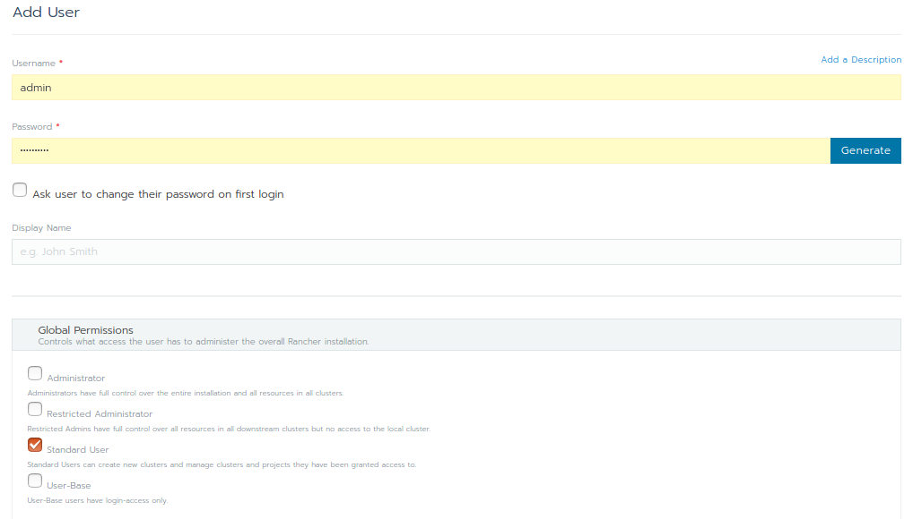
Rancher
Administrator: These users have full control over the entire Rancher system and all clusters within it.
Restricted-admin: role was created in Rancher v2.5 in order to prevent privilege escalation from the local Rancher server Kubernetes cluster. This role has full administrator access to all downstream clusters managed by Rancher, but it does not have permission to alter the local Kubernetes cluster.
Standard User: These users can create new clusters and use them.
User-Base: User-Base users have login-access only.

Slide 5
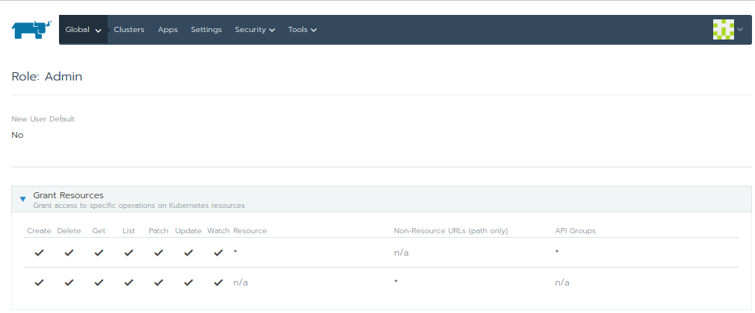
https://www.youtube.com/watch?v=-ZhiaF6BD5o

Slide 6
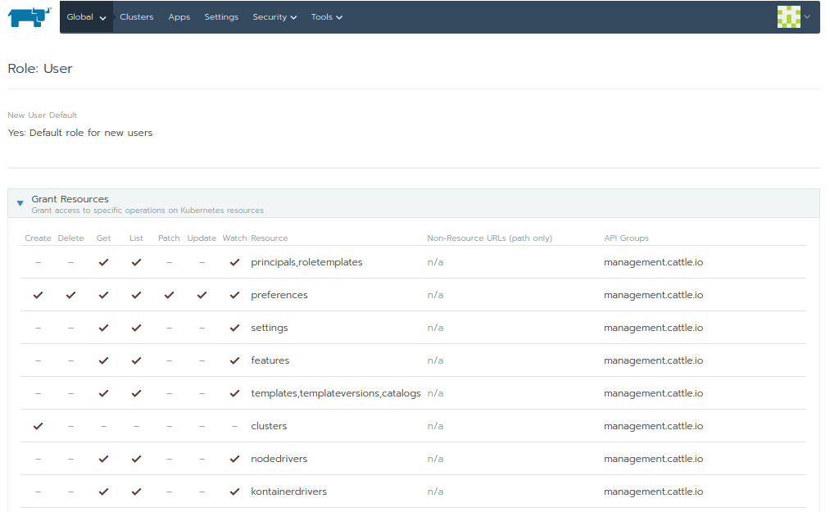
https://rancher.com/docs/rancher/v2.x/en/cluster-admin/cluster-access/cluster-members/?query=project
https://rancher.com/docs/rancher/v2.x/en/deploy-across-clusters/multi-cluster-apps/

Slide 7
MECM Administrator user role support - soln 1
Allow Admin to have full access rights on tenants resources.
Allow Admin to query all the tenants details (query user-mgmt for all tenants info).
Allow Admin to perform app/update/delete action(config/lcm) on selected tenant.
Allow admin to view configurations, distribution and deployment info of all tenants.
Allow admin to add/update/delete edge configuration i.e, Applcm, AppruleMgr, AppStore, MecHost for a particular tenant.
Note: Allow only admin to create edge configurations(applcm, apprule, mechost, appstore).

Slide 8
Interface change to support admin operations.
No change in any of the existing APIs in mecm-be
Allow admin to add/update/delete edge configuration i.e, Applcm, AppruleMgr, AppStore, MecHost for a particular selected tenant by authorizing tenant with role as MECM_admin in the token.
mecm-fe has to form mecm-be URL’s with the admin selected tenant ID for any actions (edge config i.e, Applcm, AppruleMge, AppStore, MecHost, application lcm operations and app rule configurations).
mecm-be should provide new interface to query all the tenants configurations, distribution info and deployment informations etc… when authorization role is MECM_admin in the token
Modify all query interfaces to include tenant id in the response body of all the queries.

Slide 9
MECM Administrator user support - Soln 2
Allow Admin to have full access rights on tenants resources.
Allow admin to view configurations, distribution and deployment info of all tenants.
Allow Admin to perform update/delete action(config/lcm) on selected resource.
Note: Allow only tenants to create edge configurations (applcm, apprule, appstore, mechost).

Slide 10
Interface change to support admin operations.
No change in any of the existing APIs in mecm-be
Allow admin to update/delete edge configuration i.e, Applcm, AppruleMgr, AppStore, MecHost for a particular selected resource by authorizing tenant with role as MECM_admin in the token.
mecm-fe has to form mecm-be URL’s with the admin selected tenant resource for any actions (edge config i.e, Applcm, AppruleMge, AppStore, MecHost, application lcm operations and app rule configurations).
mecm-be should provide new interface to query all the tenants configurations, distribution info and deployment informations etc… when authorization role is MECM_admin in the token
Modify all query interfaces to include tenant id in the response body of all the queries.

Slide 11
MECM Configuration API’s(Existing API’s)
Admin login
mecm-fe
?
appo
inventory
apm
Lcm Ctrl
Get all Tenants
Select tenant to perform operations
/inventory/v1/tenants/{tenant_id}/applcms
Configure applcm, host, app rule etc….
form inventory url with selected tenantID
preAuthorize request with role MECM_ADMIN is allowed
/apm/v1/tenants/{tenant_id}/packages
form apm url with selected tenantID
On-board application package
preAuthorize request with role MECM_ADMIN/MECM_TENANT is allowed
/appo/v1/tenants/{tenant_id}/app_instances/{app_instance_id}
form appo url with selected tenantID
Instantiate app
preAuthorize request with role MECM_ADMIN/MECM_TENANT is allowed
/inventory/v1/tenants/{tenant_id}/mechosts/{mechost_ip}/k8sconfig
form inventory url with selected tenantID
preAuthorize request with role MECM_ADMIN is allowed

Slide 12
MECM new Query all API’s
Admin login
mecm-fe
?
appo
inventory
apm
GET /inventory/v1/applcms
GET /inventory/v1/hosts
GET /inventory/v1/apprules
Query applcm, host, app rule etc….
preAuthorize request with role MECM_ADMIN allowed
Query application package
GET /apm/v1/tenants/packages
preAuthorize request with role MECM_ADMIN is allowed
Get app Inst info
GET /appo/v1/app_instance_infos
preAuthorize request with role MECM_ADMIN is allowed

Slide 13
MECM Query all API’s (Existing API’s)
Admin login
mecm-fe
?
appo
inventory
apm
Get all Tenants
Select tenant to perform operations
GET /inventory/v1/tenants/{tenant_id}/applcms
GET /inventory/v1/tenants/{tenant_id}/hosts
GET /inventory/v1/tenants/{tenant_id}/apprules
Query applcm, host, app rule etc….
preAuthorize request with role MECM_ADMIN/MECM_TENANT/MECM_GUEST allowed
Query application package
GET /apm/v1/tenants/{tenant_id}/packages
preAuthorize request with role MECM_ADMIN/MECM_TENANT/MECM_GUEST is allowed
Get app Inst info
GET /appo/v1/tenants/{tenant_id}/app_instance_infos
preAuthorize request with role MECM_ADMIN/MECM_TENANT/MECM_GUEST is allowed

Slide 14
MECM-FE design (TBD: yangyang)

Slide 15
THANK YOU

Slide 16
Backup slides

Slide 17
Soln -2 : Interface change to support admin operations.
Need modification in existing configurations APIs
Allow admin to configuration edge configurations i.e, Applcm, AppruleMgr, AppStore, MecHost at global level.
mecm-be should provide new interface to query all the tenants configurations, distribution info and deployment informations etc… when authorization role is MECM_admin in the token
Modify all query interfaces to include tenant id in the response body of all the queries.

Slide 18
Soln 2: Interface changes
Existing APIs
Modified APIs
GET /inventory/v1/tenants/{tenant_id}/applcms
GET /inventory/v1/tenants/{tenant_id}/applcms/{applcm_ip}
PUT /inventory/v1/tenants/{tenant_id}/applcms/{applcm_ip}
POST /inventory/v1/tenants/{tenant_id}/applcms
DELETE /inventory/v1/tenants/{tenant_id}/applcms
DELETE /inventory/v1/tenants/{tenant_id}/applcms/{applcm_ip}
GET /inventory/v1/tenants/{tenant_id}/appstores
POST /inventory/v1/tenants/{tenant_id}/appstores
DELETE /inventory/v1/tenants/{tenant_id}/appstores
GET /inventory/v1/tenants/{tenant_id}/appstores/{appstore_ip}
PUT /inventory/v1/tenants/{tenant_id}/appstores/{appstore_ip}
DELETE /inventory/v1/tenants/{tenant_id}/appstores/{appstore_ip}
GET /inventory/v1/tenants/{tenant_id}/mechosts
POST /inventory/v1/tenants/{tenant_id}/mechosts
DELETE /inventory/v1/tenants/{tenant_id}/mechosts
GET /inventory/v1/tenants/{tenant_id}/mechosts/{mechost_ip}
PUT /inventory/v1/tenants/{tenant_id}/mechosts/{mechost_ip}
DELETE /inventory/v1/tenants/{tenant_id}/mechosts/{mechost_ip}
GET /inventory/v1/tenants/{tenant_id}/mechosts/{mechost_ip}/capabilities
GET /inventory/v1/tenants/{tenant_id}/mechosts/{mechost_ip}/capabilities/{capability_type}/applications
POST /inventory/v1/tenants/{tenant_id}/mechosts/{mechost_ip}/k8sconfig
DELETE /inventory/v1/tenants/{tenant_id}/mechosts/{mechost_ip}/k8sconfig
GET /inventory/v1/tenants/{tenant_id}/apprulemanagers
GET /inventory/v1/tenants/{tenant_id}/apprulemanagers/{app_rule_manager_ip}
DELETE /inventory/v1/tenants/{tenant_id}/apprulemanagers
DELETE /inventory/v1/tenants/{tenant_id}/apprulemanagers/{app_rule_manager_ip}
GET /inventory/v1/applcms
GET /inventory/v1/applcms/{applcm_ip}
PUT /inventory/v1/applcms/{applcm_ip}
POST /inventory/v1/applcms
DELETE /inventory/v1/applcms
DELETE /inventory/v1/applcms/{applcm_ip}
GET /inventory/v1/appstores
POST /inventory/v1/appstores
DELETE /inventory/v1/appstores
GET /inventory/v1/appstores/{appstore_ip}
PUT /inventory/v1/appstores/{appstore_ip}
DELETE /inventory/v1/appstores/{appstore_ip}
GET /inventory/v1/mechosts
POST /inventory/v1/mechosts
DELETE /inventory/v1/mechosts
GET /inventory/v1/mechosts/{mechost_ip}
PUT /inventory/v1/mechosts/{mechost_ip}
DELETE /inventory/v1/mechosts/{mechost_ip}
GET /inventory/v1/mechosts/{mechost_ip}/capabilities
GET /inventory/v1/mechosts/{mechost_ip}/capabilities/{capability_type}/applications
POST /inventory/v1/mechosts/{mechost_ip}/k8sconfig
DELETE /inventory/v1/mechosts/{mechost_ip}/k8sconfig
GET /inventory/v1/apprulemanagers
GET /inventory/v1/apprulemanagers/{app_rule_manager_ip}
DELETE /inventory/v1/apprulemanagers
DELETE /inventory/v1/apprulemanagers/{app_rule_manager_ip}

